Slide 1
Online Community Monitoring
Tracking Changes in Subreddit Sentiments
Natural Language Processing
DATS 6312, Section 11
Team 3, Final Project
Ashish Telukunta, Jonathan Schild, Thomas Stanton

Slide 2
Project Outline
Conceptualization/description
Training model to predict emotion and sentiment of text
Scrape Reddit data
Apply model(s)
Plot sentiments over time

Slide 3
Model Approach
Data
Model identification
Positive/Negative sentiment
Hugging Face’s pipeline
Emotions
BERT1, BERT2 (pseudo-labeling)
RoBERTa
ELECTRA
Tuning
Hyperparameters
Optimizer, Loss function

Slide 4
Model Performances
Model | Validation Accuracy | F1 Score
BERT1 (w/o Reddit data) | 0.9520 | 0.9582
BERT2 (w/Reddit data) | 0.9100 | 0.9140
Electra | 0.9531 | 0.9530
Roberta | 0.9502 | 0.9502

Slide 5
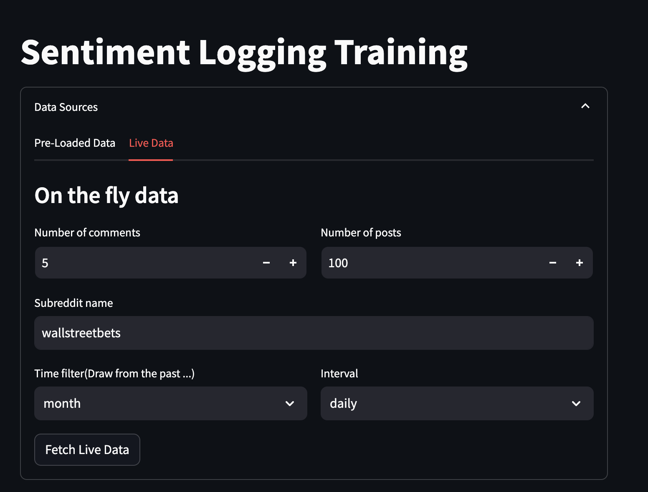
Reddit Scraper
Praw
Duration restrictions: day, week, month, year
No ability to specify date ranges
Data retrieved
Posts & comments; specify number of each
Dates; enable grouping and averaging

Slide 6
Model Application: Preview
Scrape parameters
Top 40 comments for the top 50 posts
For past month, grouped to daily intervals
Examples…
r/pics
r/funny
r/wallstreetbets
r/gwu

Slide 7
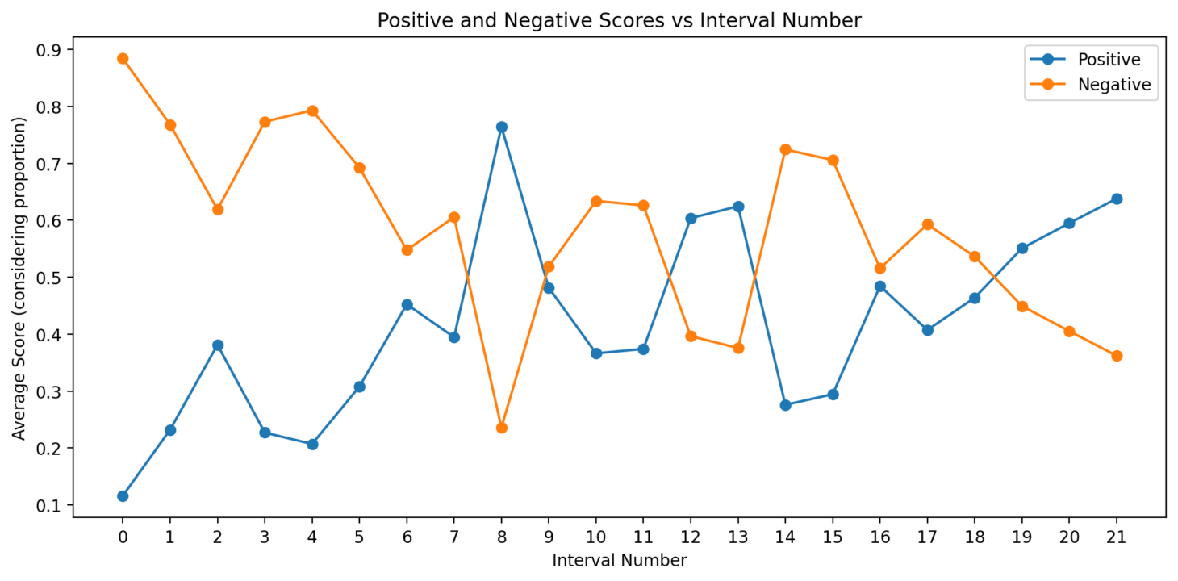
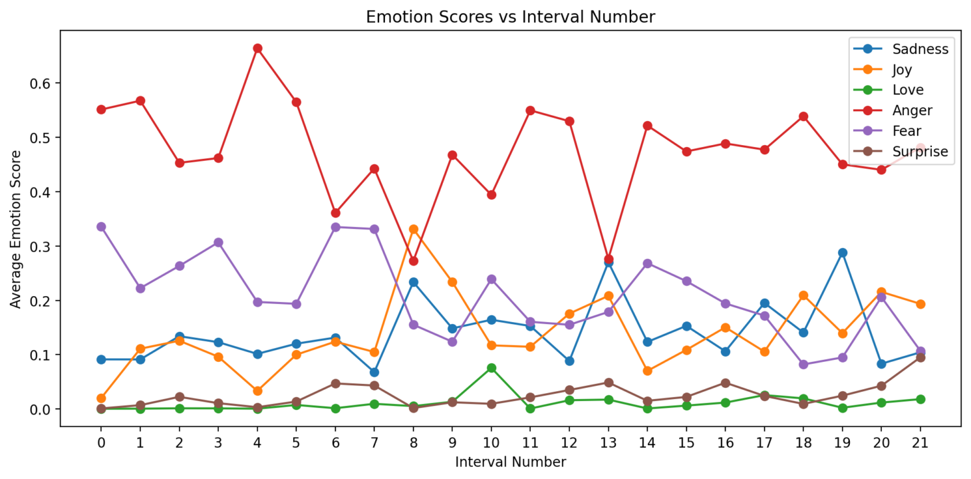
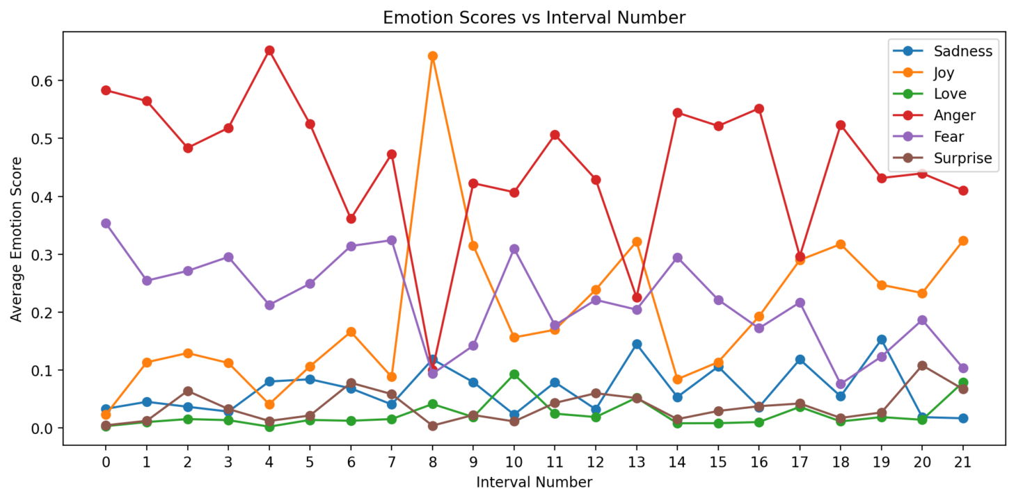
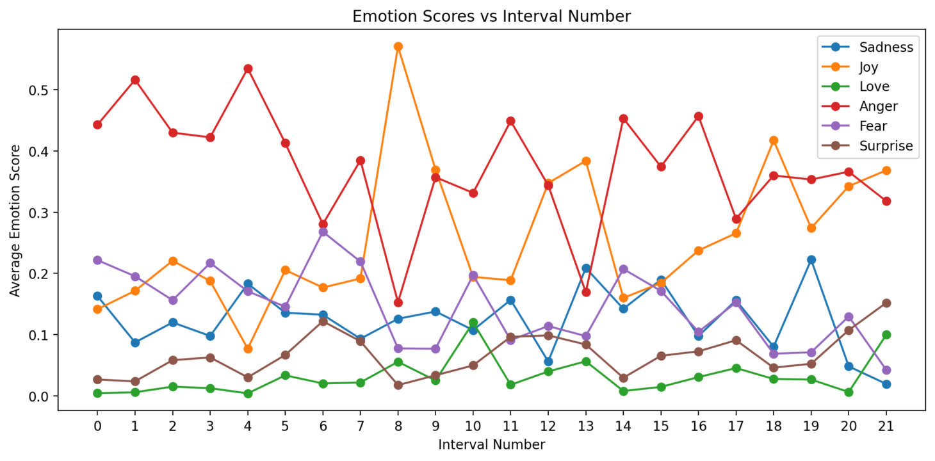
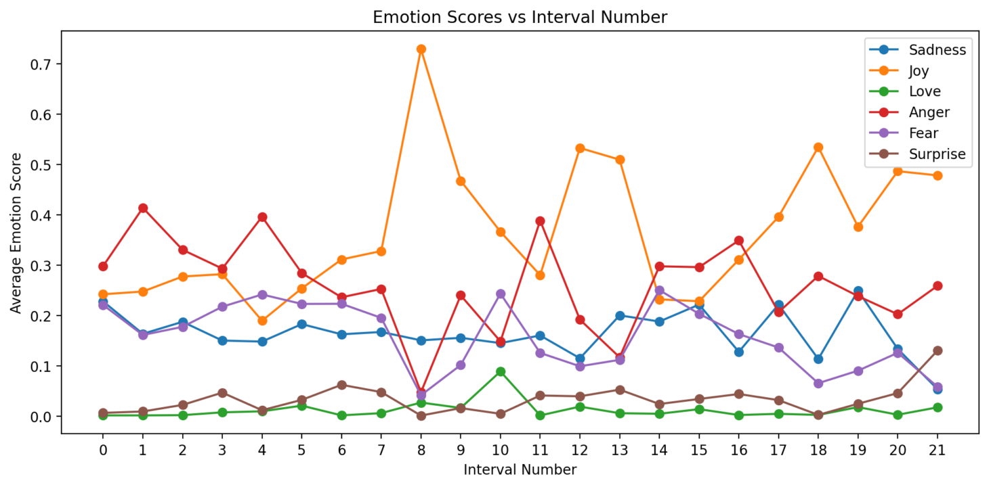
r/pics…
Bert1
RoBerta
Electra
Bert2

Slide 8
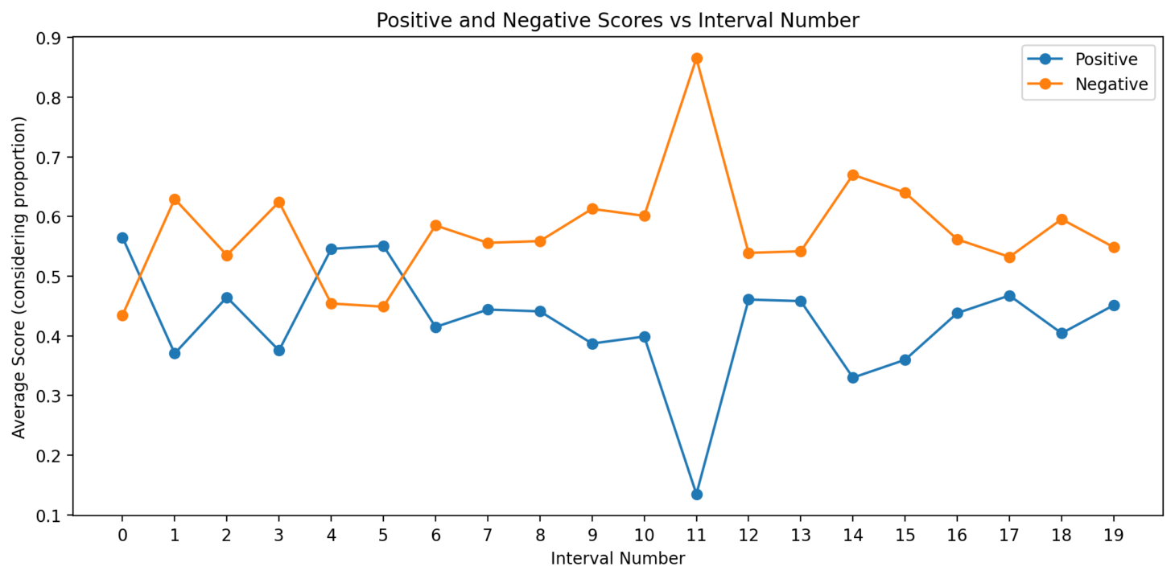
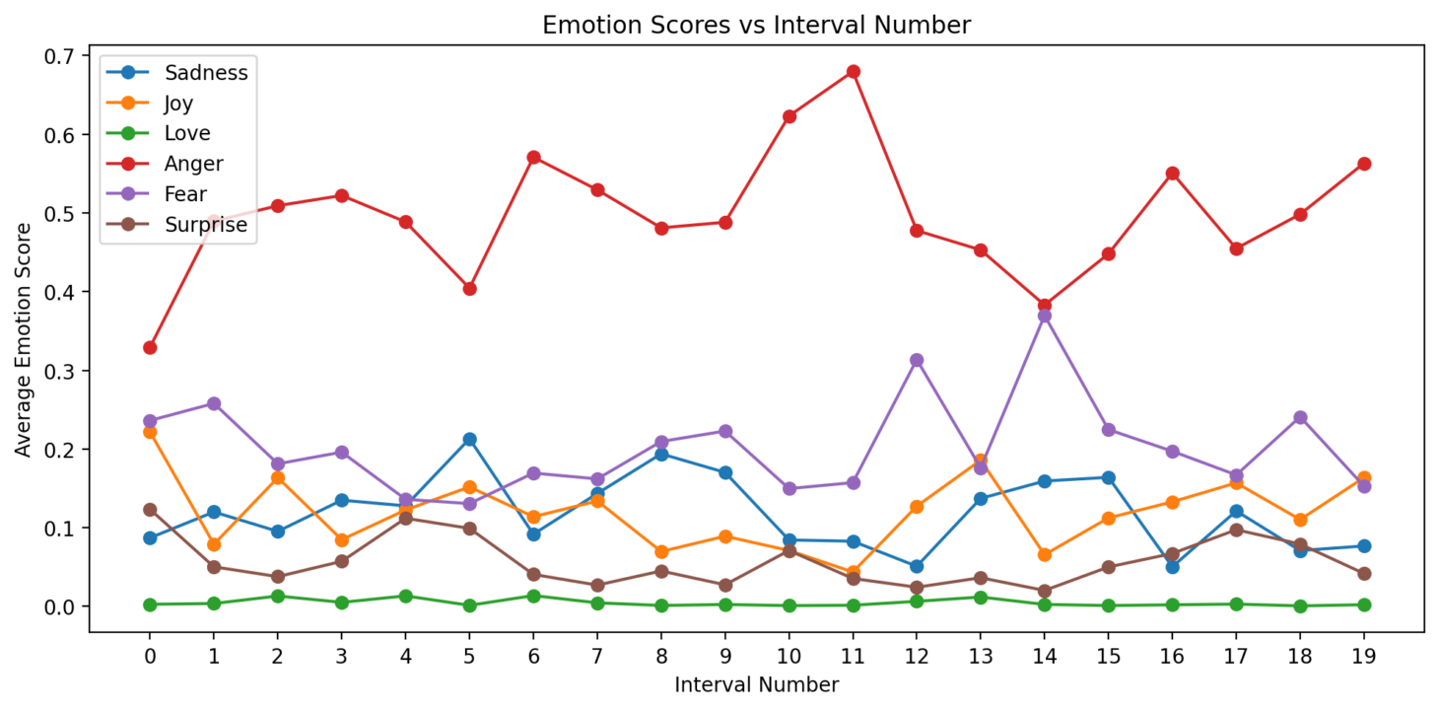
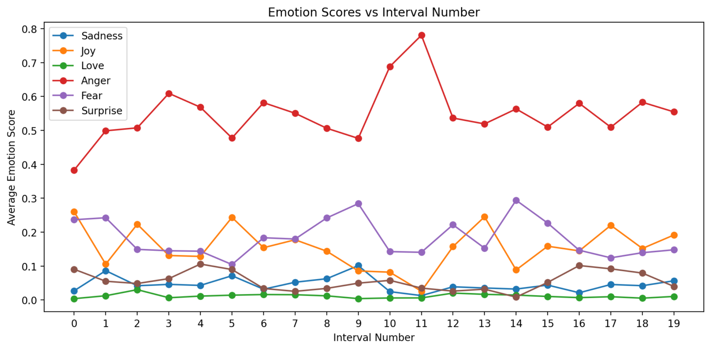
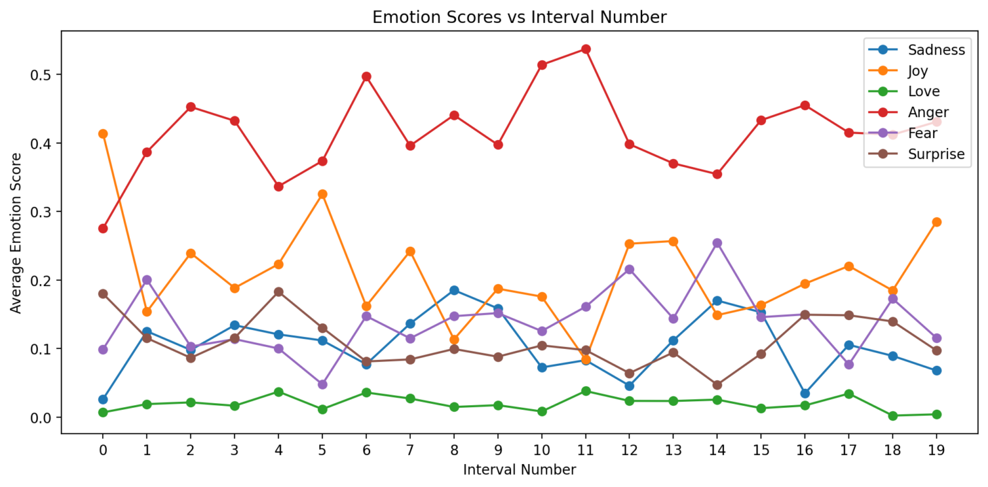
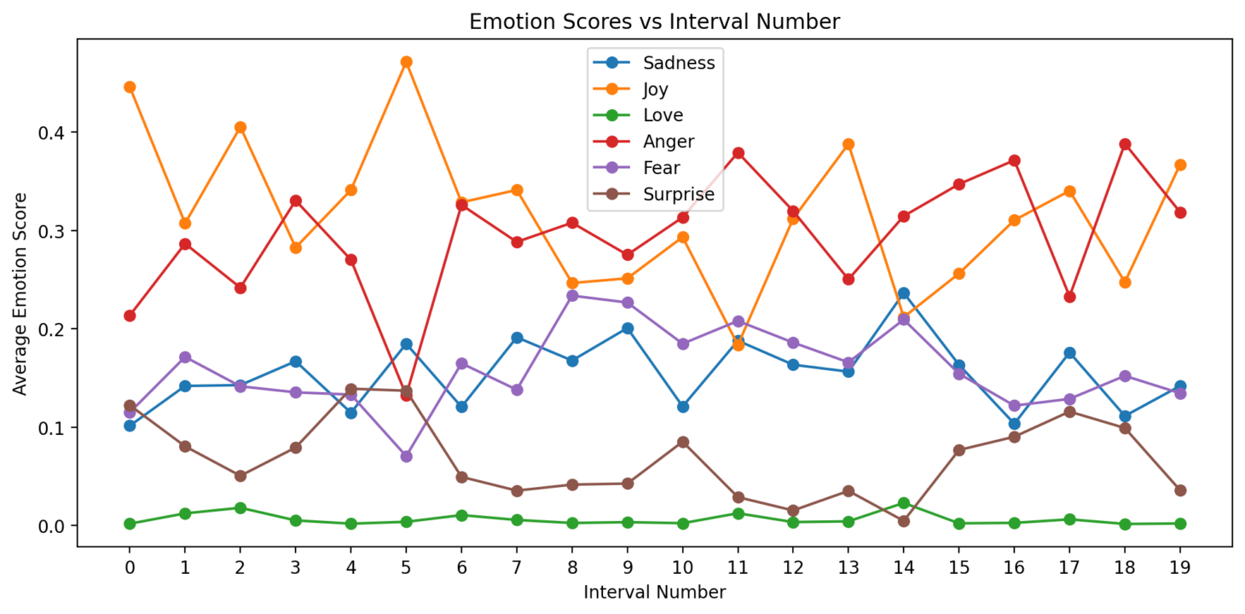
r/funny…
RoBerta
Bert1
Electra
Bert2

Slide 9
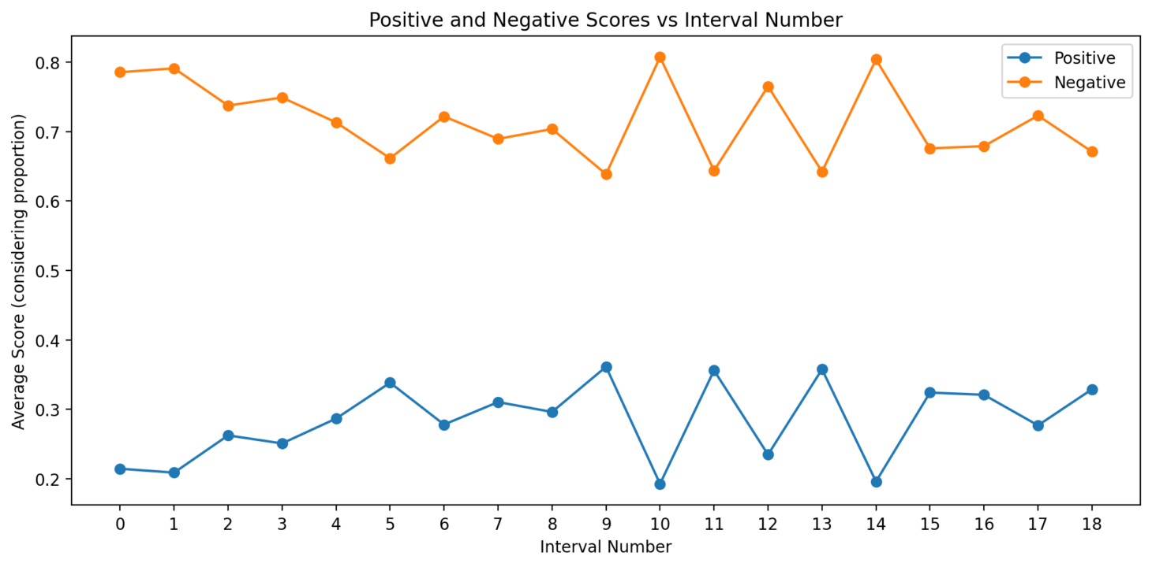
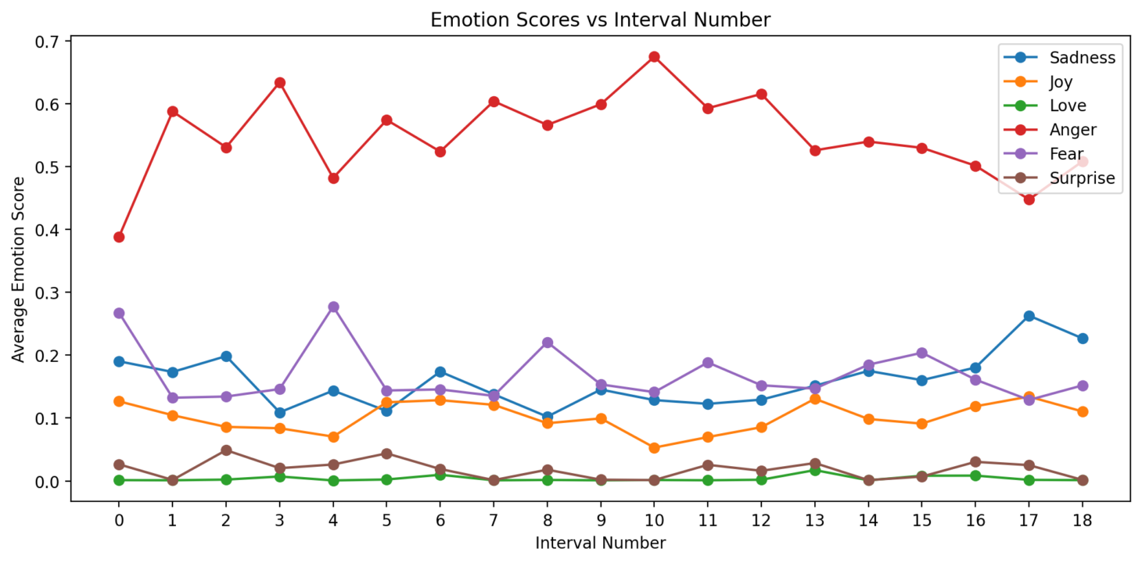
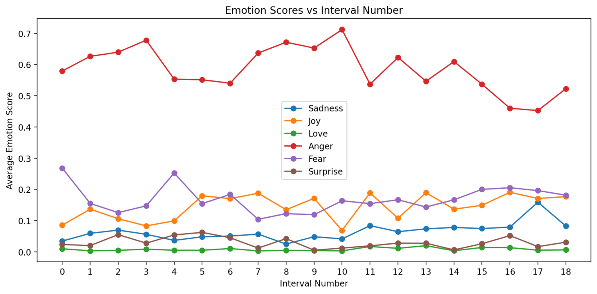
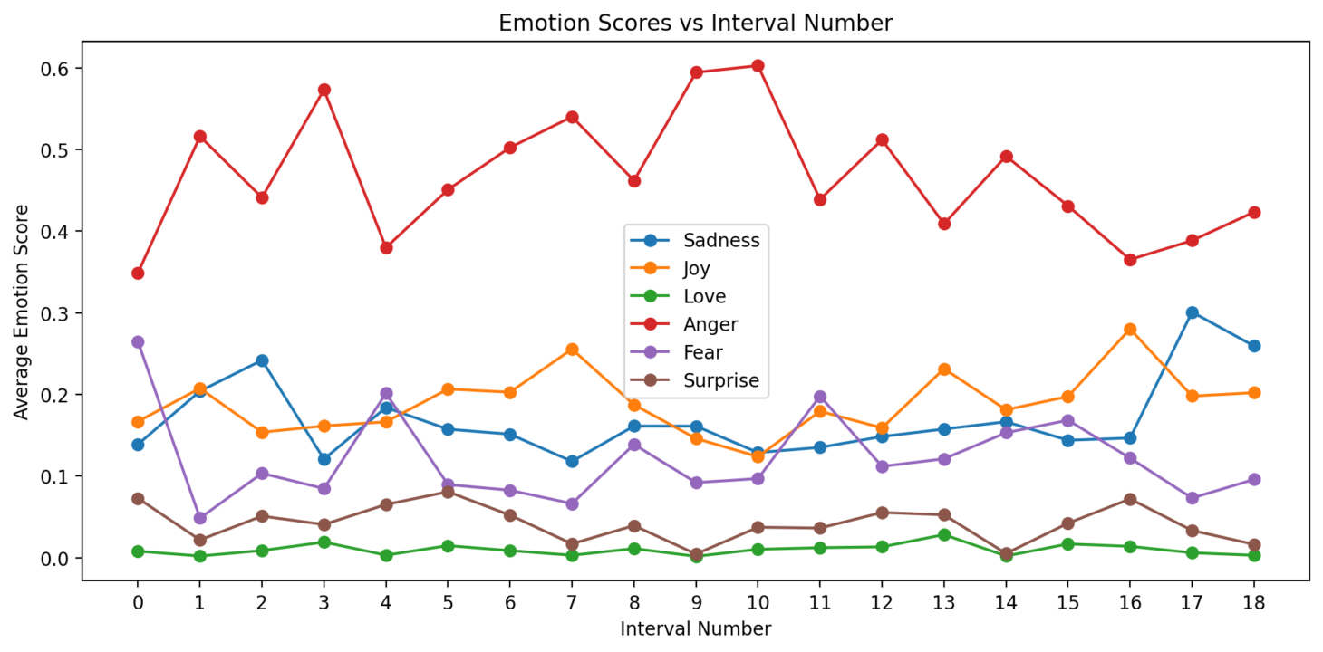
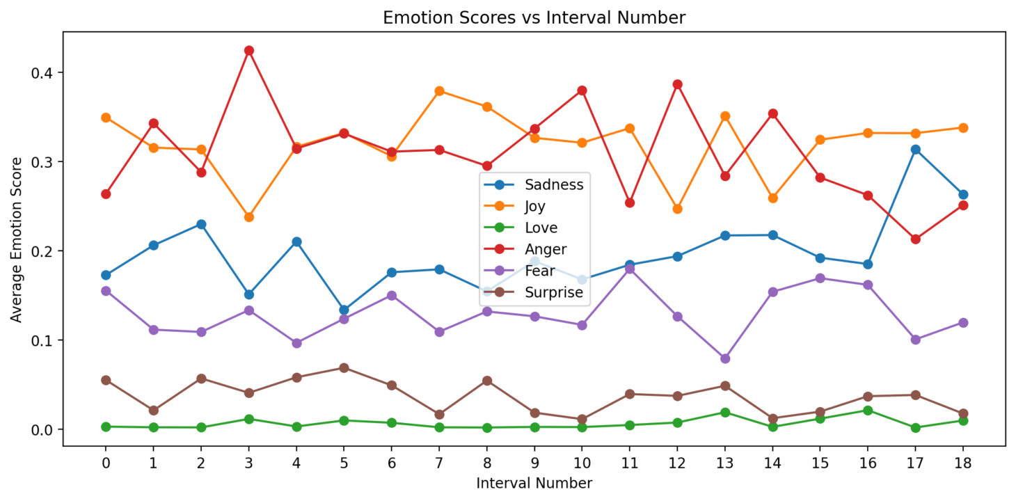
r/wallstreetbets...
Bert1
RoBerta
Electra
Bert2

Slide 10
Demonstration...

